Slide 1
Nessie: A Decoupled, Client-Driven,Key-Value Store using RDMA
Zhentao Xie 2019.5.5

Slide 2
Contents
1. Background
2. Design
3. Evaluation

Slide 3
Background

Slide 4
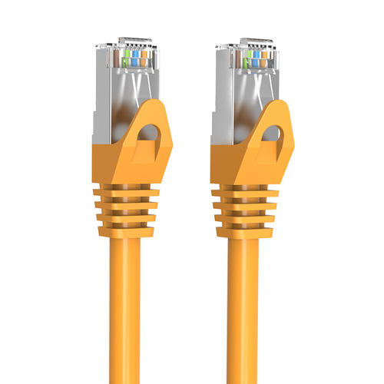
Background
Network protocols : TCP/UDP
Notes:
数据库传统通信是网络传输
对于重心在本地计算的应用足够
但大规模数据读写的应用，网络瓶颈

Slide 5
Background
Network protocols : TCP/UDP
Bottleneck : NETWORK
Notes:
采用速度更快的RDMA

Slide 6
Background
Network protocols : TCP/UDP
Bottleneck : NETWORK
Solution ：Network--->RDMA，RKVS

Slide 7
Background
RDMA operations
one-sided
two-sided
RKVS(RDMA-enabled key-value stores)
GET, PUT
CD(client-driven), SD(server-driven)
Notes:
数据库传统通信是网络传输
对于重心在本地计算的应用足够
但大规模数据读写的应用，网络瓶颈

Slide 8
Background
Pilaf
GET : READ
PUT : SEND/RECV
Partially-coupled
Notes:
数据库传统通信是网络传输
对于重心在本地计算的应用足够
但大规模数据读写的应用，网络瓶颈

Slide 9
Background
FaRM
GET : READ
PUT : 2*WRITE
Complete-coupled
Notes:
数据库传统通信是网络传输
对于重心在本地计算的应用足够
但大规模数据读写的应用，网络瓶颈

Slide 10
Background
HERD
GET : WRITE, SEND/RECV
PUT : WRITE, SEND/RECV
Partially-coupled
Notes:
数据库传统通信是网络传输
对于重心在本地计算的应用足够
但大规模数据读写的应用，网络瓶颈

Slide 11
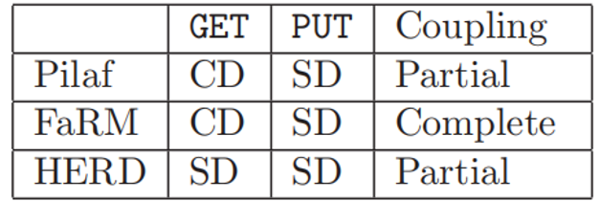
Background
Notes:
数据库传统通信是网络传输
对于重心在本地计算的应用足够
但大规模数据读写的应用，网络瓶颈

Slide 12
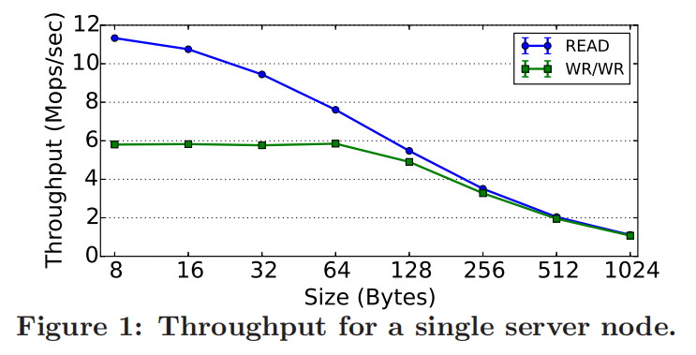
Background
Test
Notes:
数据库传统通信是网络传输
对于重心在本地计算的应用足够
但大规模数据读写的应用，网络瓶颈

Slide 13
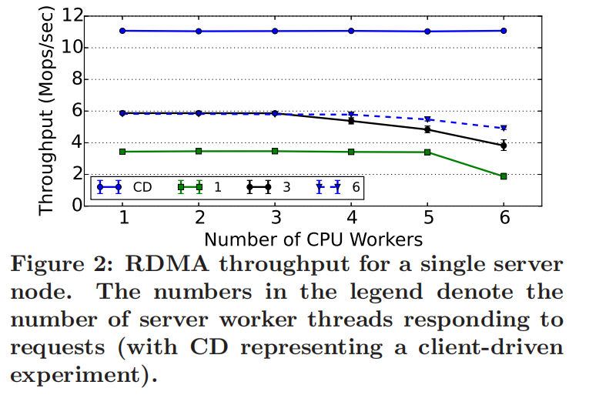
Background
Test
Notes:
数据库传统通信是网络传输
对于重心在本地计算的应用足够
但大规模数据读写的应用，网络瓶颈

Slide 14
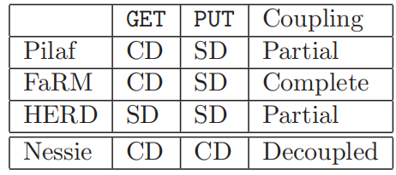
Background
Nessie: A Decoupled, Client-Driven,Key-Value Store using RDMA
Notes:
数据库传统通信是网络传输
对于重心在本地计算的应用足够
但大规模数据读写的应用，网络瓶颈

Slide 15
Design

Slide 16
N-way cuckoo hash
To solve the problem of hash conflict
hash_1
address_1
key
hash_2
address_2
hash_3
address_3
Notes:
布谷鸟hash

Slide 17
N-way cuckoo hash
To solve the problem of hash conflict
hash_1
address_1
hash_1
address_1
key_A
hash_2
address_2
key_B
hash_2
address_4
hash_3
address_3
hash_3
address_5
Notes:
布谷鸟hash

Slide 18
N-way cuckoo hash
To solve the problem of hash conflict
X
hash_1
address_1
hash_1
address_1
key_A
hash_2
address_2
key_B
hash_2
address_4
hash_3
address_3
hash_3
address_5
Notes:
布谷鸟hash

Slide 19
N-way cuckoo hash
To solve the problem of hash conflict
hash_1
address_1
hash_1
address_1
key_A
hash_2
address_2
key_B
hash_2
address_4
hash_3
address_3
hash_3
address_5
Notes:
布谷鸟hash

Slide 20
Design-GET
index table
data table
index table entry 2
data table entry
key
value

Slide 21
Design-GET
index table
data table
index table entry 2
data table entry
key
index table entry 1
value
index table entry 3

Slide 22
Design-GET
index table
data table
index table entry 2
data table entry
Node
RDMA READ
key
index table entry 1
value
index table entry 3

Slide 23
Design-GET
index table
data table
index table entry 2
data table entry
Node
RDMA READ
RDMA READ
key
index table entry 1
value
index table entry 3

Slide 24
Design-GET
index table
data table
index table entry 2
data table entry
Node
RDMA READ
？
RDMA READ
key
index table entry 1
value
index table entry 3

Slide 25
Design-GET
index table
data table
index table entry 2
data table entry
Node
RDMA READ
？
RDMA READ
key
？
index table entry 1
value
index table entry 3

Slide 26
Design-GET
Index table entry--64 bits
data table identifier | offset | version number | watermark
15 bits
32 bits
16 bits
1 bit

Slide 27
Design-GET
Index table entry--64 bits
data table identifier | filter | offset | version number | watermark
x bits
15-x bits
32 bits
16 bits
1 bit
filter : trailing bits from a key's hash

Slide 28
Design-GET
data table entry
key | value | valid

Slide 29
Migration
PUT
hash_1
address_1
key
hash_2
address_2
hash_3
address_3
Notes:
布谷鸟hash

Slide 30
Migration
PUT
X
hash_1
address_1
key
hash_2
address_2
hash_3
address_3
Notes:
布谷鸟hash

Slide 31
Migration
PUT
X
hash_1
address_1
X
key
hash_2
address_2
hash_3
address_3
Notes:
布谷鸟hash

Slide 32
Migration
PUT
X
hash_1
address_1
X
key
hash_2
address_2
X
hash_3
address_3
Notes:
布谷鸟hash

Slide 33
Migration
PUT
√
hash_1
address_1
key
hash_2
address_2
hash_3
address_3
Notes:
布谷鸟hash

Slide 34
Design-GET
GET
hash_1
address_1
X
hash_2
address_2
hash_3
address_3
key_1
hash_4
address_4
hash_5
address_5
hash_6
address_6
hash_7
address_7
Notes:
布谷鸟hash

Slide 35
Design-GET
GET
hash_1
address_1
X
hash_2
address_2
X
hash_3
address_3
key_1
hash_4
address_4
hash_5
address_5
hash_6
address_6
hash_7
address_7

Slide 36
Design-GET
GET
hash_1
address_1
X
hash_2
address_2
X
hash_3
address_3
X
key_1
hash_4
address_4
hash_5
address_5
hash_6
address_6
hash_7
address_7

Slide 37
Design-GET
GET
hash_1
address_1
X
hash_2
address_2
X
hash_3
address_3
X
key_1
hash_4
address_4
PUT(key_2,value_2)
hash_5
address_5
hash_6
address_6
hash_7
address_7

Slide 38
Design-GET
PUT(key_2,value_2)
hash_1
address_4
hash_2
hash_3
key_2
hash_4
hash_5
hash_6
hash_7

Slide 39
Design-GET
PUT(key_2,value_2)
hash_1
address_4
X
hash_2
X
hash_3
X
key_2
X
hash_4
hash_5
X
hash_6
X
hash_7
X

Slide 40
Design-GET
PUT(key_2,value_2)
hash_1
address_4
migration
hash_2
hash_3
key_2
hash_4
hash_5
hash_6
hash_7
Notes:
布谷鸟hash

Slide 41
Design-GET
Migration
hash_1
address_1
migration
hash_2
address_2
hash_3
address_3
key_1
hash_4
address_4
hash_5
address_5
hash_6
address_6
hash_7
address_7
Notes:
布谷鸟hash

Slide 42
Design-GET
GET
hash_1
address_1
X
hash_2
address_2
X
hash_3
address_3
X
key_1
hash_4
address_4
hash_5
address_5
hash_6
address_6
hash_7
address_7
Notes:
布谷鸟hash

Slide 43
Design-GET
GET
hash_1
address_1
X
hash_2
address_2
X
hash_3
address_3
X
key_1
X
hash_4
address_4
hash_5
address_5
X
hash_6
address_6
X
hash_7
address_7
X
Notes:
布谷鸟hash

Slide 44
Design-GET
Index table entry--64 bits
data table identifier | filter | offset | version number | watermark
x bits
15-x bits
32 bits
16 bits
1 bit
version number++ when modified

Slide 45
Design-GET
Fetch all N index table entries
again and check version number
when GET operation fails
hash_1
address_1
hash_2
address_2
hash_3
address_3
key_1
hash_4
address_4
hash_5
address_5
hash_6
address_6
hash_7
address_7
Notes:
布谷鸟hash

Slide 46
Design-GET
Trade-off
performance
correctness
hash_1
address_1
hash_2
address_2
hash_3
address_3
key_1
hash_4
address_4
hash_5
address_5
hash_6
address_6
hash_7
address_7
Notes:
布谷鸟hash

Slide 47
Design-PUT
PUT(key,value)
key | value | valid

Slide 48
Design-PUT
PUT(key,value)
local memory access VS RDMA
key | value | valid

Slide 49
Design-PUT
PUT(key,value)
local memory access VS RDMA
23 times faster
key | value | valid

Slide 50
Design-PUT
local data table
PUT(key,value)
Write data table entry
data table entry
key | value | valid（0）

Slide 51
Design-PUT
index table
local data table
index table entry
data table entry
index table entry
Otherwise,write and insert a new index table entry
key
index table entry
index table entry

Slide 52
Design-PUT
index table
local data table
index table entry
data table entry
index table entry
Otherwise,write and insert a new index table entry
key
index table entry
index table entry

Slide 53
Design-PUT
index table
local data table
index table entry
data table entry
index table entry
Otherwise,write and insert a new index table entry
key
index table entry
index table entry

Slide 54
Design-PUT
index table
local data table
index table entry
data table entry
index table entry
REUSE
Otherwise,write and insert a new index table entry
key
index table entry
index table entry

Slide 55
Design-DELETE
DELETE
hash_1
index entry_1
data entry_1
hash_2
index entry_2
hash_3
index entry_3
key
hash_4
index entry_4
hash_5
index entry_5
hash_6
index entry_6
data entry_2
hash_7
index entry_7
Notes:
布谷鸟hash

Slide 56
Design-DELETE
DELETE
hash_1
index entry_1
data entry_1
hash_2
index entry_2
hash_3
index entry_3
key
hash_4
index entry_4
hash_5
index entry_5
REUSE
hash_6
index entry_6
data entry_2
X
hash_7
index entry_7
Notes:
布谷鸟hash

Slide 57
Design-REUSE
Inform the corresponding node when the index table entry modified
Target node set it free

Slide 58
Design-REUSE
index table
data table
index table entry
data table entry
GET
key

Slide 59
Design-REUSE
index table
data table
index table entry
data table entry
DELETE
key
X
REUSE

Slide 60
Design-REUSE
data table
data table entry
PUT

Slide 61
Design-REUSE
data table
data table entry
GET
Node

Slide 62
Design-REUSE
Solution:
delaying the reuse of a data table entry by a specified amount of time.

Slide 63
Evaluation

Slide 64
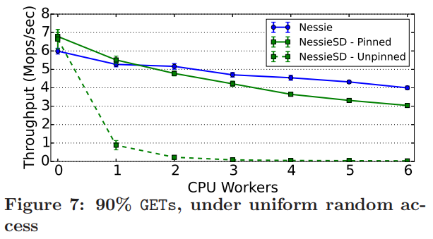
Evaluation
NessieSD, inspired by HERD

Slide 65
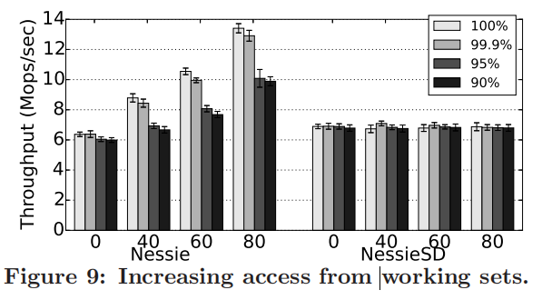
Evaluation

Slide 66
Evaluation

Slide 67
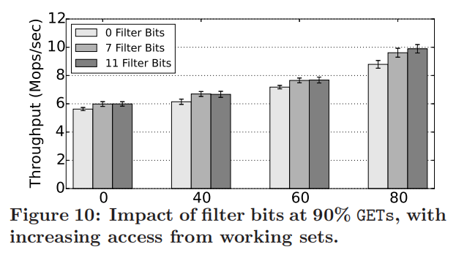
Evaluation

Slide 68
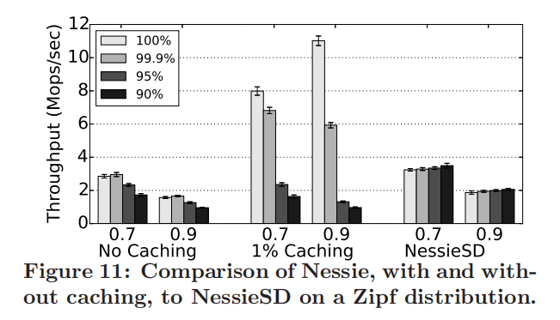
Evaluation

Slide 69

Thank You！

